Slide 1

Introduction to CSS

Slide 2
What is CSS?
CSS ("Cascading Style Sheets") determines how the elements in our XHTML documents are displayed and formatted.
By using CSS, we separate the content of a web page from the presentation (format and styling) of that content.
CSS enables us to make all pages of our website look similar and consistent.
The power of CSS is that it allows us to make site-wide formatting changes by making edits to a single file.
In this course, we will be learning version 2.1 of CSS. A newer version, known as CSS3, is being increasingly adopted by web designers and web browser manufacturers.

Slide 3
Three Ways to Use CSS
We can add CSS code in any combination of three different ways:
Inline Style - CSS code is placed directly into an XHTML element within the <body> section of a web page.
Internal Style Sheet - CSS code is placed into a separate, dedicated area within the <head> section of a web page.
External Style Sheet - CSS code is placed into a separate computer file and then linked to a web page.
Let's take a look now at examples of each of these methods.

Slide 4
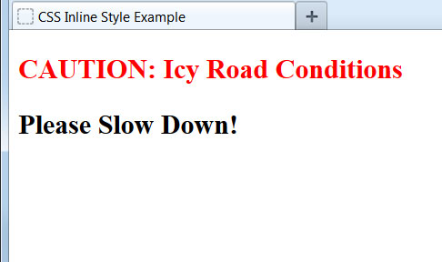
Inline Style
To define an inline CSS style, we simply add the style attribute to an XHTML element with the CSS declaration as the attribute value:
<h2 style="color:red;">CAUTION: Icy Road Conditions</h2>
<h2>Please Slow Down!</h2>
An inline style declaration is highly specific and formats just one element on the page. No other elements, including other <h2> elements on the page, will be affected by this CSS style.
Since inline styles have limited scope and do not separate content from presentation, their use is generally discouraged. We won't be using inline styles much in this class.

Slide 5
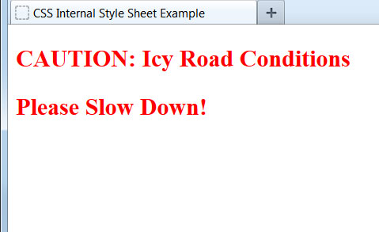
Internal Style Sheet
To use an internal CSS style sheet, we add a <style> section within the <head> of the page. All our CSS declarations go within this section:
<head>
...
<style type="text/css">
h2 {color:red;}
</style>
</head>
<body>
<h2>CAUTION: Icy Road Conditions</h2>
<h2>Please Slow Down!</h2>
</body>
Styles declared in the internal style sheet affect all matching elements on the page. In this example, all <h2> page elements are displayed in the color red.
Since formatting declarations are entirely in the <head> section, away from the actual page content, internal CSS style sheets do a much better job than inline styles at separating content from presentation.

Slide 6
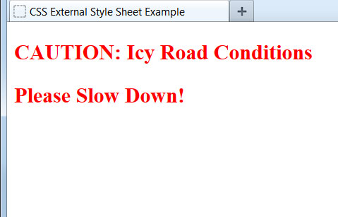
External Style Sheet
To use an external CSS style sheet, we create a new file (with a .css extension) and write our style declarations into this file. We then add a <link> element into our HTML file, right after the opening <head> tag:
style.css (separate file):
h2 {color:red;}
example.html file:
<head>
<link rel="stylesheet" type="text/css" href="style.css" />
...
</head>
<body>
<h2>CAUTION: Icy Road Conditions</h2>
<h2>Please Slow Down!</h2>
</body>
The <link> element instructs the browser to load the external file specified by the href attribute and to apply the CSS style declarations contained there.

Slide 7
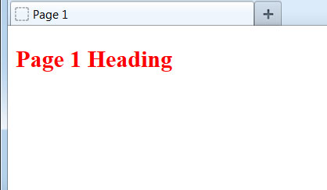

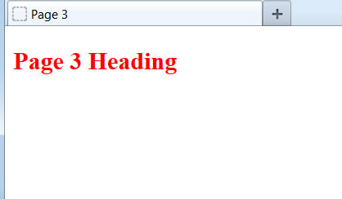
Benefit of External Style Sheet
The real power of using an external style sheet is that multiple web pages on our site can link to the same style sheet:
style.css :
h2 {color:red;}
page1.html
page2.html
page3.html
Styles declared in an external style sheet will affect all matching elements on all web pages that link to the style sheet. By editing the external style sheet, we can make site-wide changes (even to hundreds of pages) instantly.

Slide 8
Internal vs. External Style Sheets
Internal Style Sheets:
are appropriate for very small sites, especially those that have just a single page.
might also make sense when each page of a site needs to have a completely different look.
External Style Sheets:
are better for multi-page websites that need to have a uniform look and feel to all pages.
make for faster-loading sites (less redundant code).
allow designers to make site-wide changes quickly and easily.
External style sheets create the furthest separation between content and presentation. For this reason - and the others listed above - we'll consider external style sheets to be the best option when creating a new site.

Slide 9
CSS Terminology and Syntax:
Now let's take a closer look at how we write CSS code. The correct syntax of a CSS declaration is: selector {property:value;}
p {color:red;}
selector
property
value
Internal and external style sheets use this identical CSS syntax. Internal style sheets must use the opening and closing <style> tags to surround the CSS code, while external style sheets do not use the <style> element.
A semicolon must be placed after each CSS declaration. Omitting this semicolon is the single most common mistake made by those learning CSS.

Slide 10
Setting Multiple Properties
We can define as many properties as we wish for a selector:
p {color:red;font-style:italic;text-align:center;}
In this example, all text within paragraph elements will show in red italics that is centered on the page.
p {
color: red;
font-style: italic;
text-align: center;
}
Just as with HTML, browsers ignore space characters in CSS code. Many designers take advantage of this fact by placing the opening and closing curly brackets on their own dedicated lines. Each of the property and value pairings are placed on their own indented line, with a space after the colon. This makes the code far easier to read.

Slide 11
CSS Text Properties
The following properties can be specified for any element that contains text, such as <h1> through <h6>, <p>, <ol>, <ul>, and <a>:
Property Some Possible Values
text-align: center, left, right, justify
text-decoration: underline, line-through, blink
color: blue, green, yellow, red, white, etc.
font-family: Arial, Verdana, "Times New Roman"
font-size: large, 120%, 20px (pixels)
font-weight: bold, normal
font-style: italic, normal
The actual list of available properties and values is quite long, but the ones listed above are the most common for formatting text via CSS.

Slide 12
How Browsers Process CSS
A web browser will process all CSS code it encounters, even if it is from all three methods.
For example, an external style sheet could define the font of a heading, an internal style sheet could specify the font size of the heading, and an inline style could italicize the heading. All three would be applied.
Sometimes a browser will receive conflicting instructions from the CSS code. For example, what if each of the above CSS sources specified a different color for the heading text?
Browsers need a consistent way of settling these formatting conflicts in a consistent fashion. That is where the "cascade" of cascading style sheets comes into effect.

Slide 13
What Does "Cascading" Mean?
We use the term "cascading" because there is an established order of priority to resolve formatting conflicts:
Inline style (highest priority)
Internal style sheet (second priority)
External style sheet (third priority)
Web browser default (only if not defined elsewhere)
For each XHTML element, the browser will see which styles are defined inline and from internal and external style sheets. For any conflicts detected, it will use this priority system to determine which format to display on the page.
In the prior example, the heading text would display in the color specified by the inline style, which outranks all the others.
If multiple, conflicting styles are defined in the same style sheet, only the final one will be applied. Be careful, as this is another common mistake committed by beginners.

